Slide 1


Provide Insights & Performance Analysis in Transport Domain
Graduation Project at CrackNontech
Presented by Sarim Ahmad

Slide 2
Agenda
Problem Statement
Goal
Data Overview
Data Model
Dashboard Preview
Primary Analysis & Insights
Secondary Analysis & Recommendations
Ad-Hoc Business Request Reports’
Thanking Note
Sarim Ahmad

Slide 3
Problem Statement
Goodcabs, a cab service company, operates in 10 tier-2 cities in India and supports local drivers while providing excellent service to passengers. The company has set ambitious growth and passenger satisfaction targets for 2024.
The Chief of Operations needs immediate insights into key performance metrics, including trip volume, passenger satisfaction, repeat passenger rate, trip distribution, and the balance between new and repeat passengers.
However, due to the analytics manager's unavailability, the task has been assigned to me, to analyze these metrics and deliver actionable insights.
Sarim Ahmad

Slide 4
Goal
The goal of this project is to deliver actionable insights on Goodcabs' performance in 10 tier-2 cities by analyzing key metrics,
Identify growth opportunities by understanding trip trends.
Boost customer retention by increasing repeat passenger rates.
Optimize operations by balancing new and repeat passenger engagement.
Support strategic decision-making to achieve 2024 performance targets.
Sarim Ahmad

Slide 5
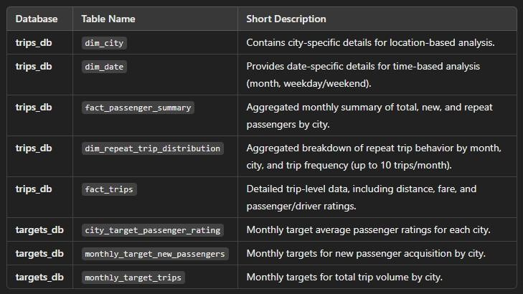
Data Overview
Dataset are available for 6 months duration from January 2024 to June 2024.
I have created new table named City Category which have info about (tourism and business focused cities)
Sarim Ahmad

Slide 6
Dashboard Preview
Live Dashboard Link
Sarim Ahmad

Slide 7
Primary Analysis and Insights
Sarim Ahmad

Slide 8
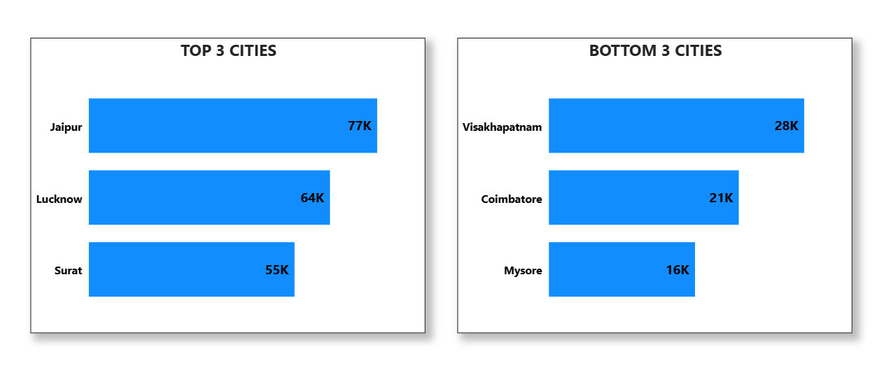
1. Identify the top 3 and bottom 3 cities by total trips over the entire analysis period.
Sarim Ahmad

Slide 9
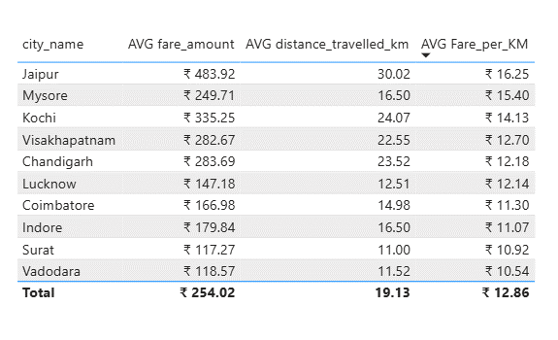
2. Calculate the average fare per trip for each city and compare it with the city's average trip distance. Identify the cities with the highest and lowest average fare per trip to assess pricing efficiency across locations.
Sarim Ahmad

Slide 10
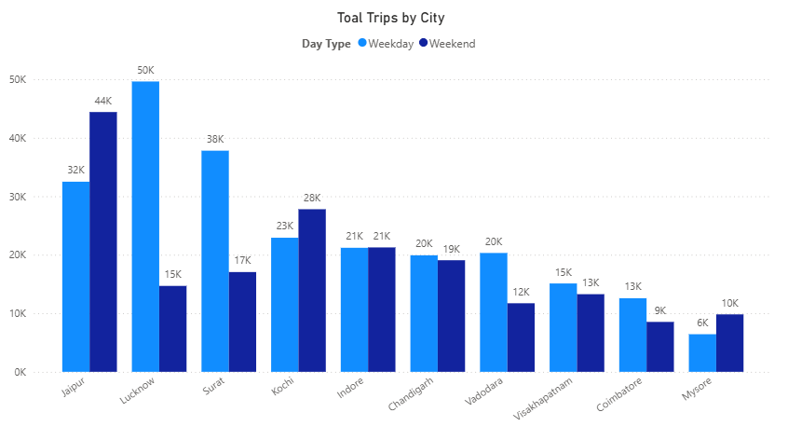
3. Compare the total trips taken on weekdays versus weekends for each city over the six-month period. Identify cities with a strong preference for either weekend or weekday trips to understand demand variations.
Sarim Ahmad

Slide 11
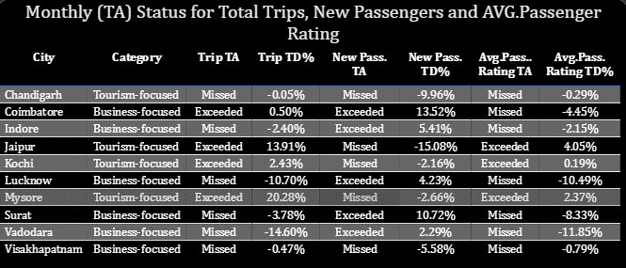
4. For each city, evaluate monthly performance against targets for total trips, new passengers, and average passenger ratings. Determine if each metric met, exceeded, or missed the target, and calculate the percentage difference.
Sarim Ahmad

Slide 12
Secondary Analysis & Recommendations
Sarim Ahmad

Slide 13
1. Factors Influencing Repeat Passenger Rates
Use the data points like repeat passenger count, passenger ratings, city demographics, and pricing data to identify patterns.
Insights:
Higher repeat passenger rates may correlate with better passenger ratings, indicating quality service.
Competitive pricing might attract more repeat passengers in cities with a price-sensitive demographic.
Socioeconomic factors: Cities with higher-income groups may prefer premium services, whereas lower-income groups may prefer cost-effective services.
Lifestyle patterns: Cities with high professional populations (e.g., IT hubs) may show consistent repeat usage during weekdays.
Recommendation:
Focus on improving service quality and offering personalized pricing plans for cities with lower repeat rates.
Sarim Ahmad

Slide 14
2. Tourism vs. Business Demand Impact
Cross-referenced trip data with event calendars (festivals, conferences, tourism seasons) over 6 months.
Insights:
Cities with high tourism activities (e.g., Jaipur, Kochi) show demand spikes during festive seasons or vacations.
Business-oriented cities (e.g., Lucknow, Surat) show consistent weekday demand.
Recommendation:
Tailor marketing efforts to highlight tourism-related campaigns in high-demand periods.
offer flexible services for business travelers e.g., loyalty program, ride packages for conferences.
Sarim Ahmad

Slide 15
3. 3. Emerging Mobility Trends and Goodcabs' Adaptation
Evaluate trends like adoption of electric vehicles, passenger preferences for green energy, and emerging mobility needs.
Insights:
Electric Vehicle (EV) Adoption: Growing preference for green transport in tier-2 cities. EV could reduce operational costs and appeal to environmentally conscious passengers.
Sustainability Focus: Eco-conscious passengers favor ride-sharing and low-emission options.
Recommendation:
Gradually integrate electric or hybrid vehicles in tier-2 cities to stay competitive and consider offering discounts on eco-friendly Rides.
Sarim Ahmad

Slide 16
Ad-Hoc Business Requests
Sarim Ahmad

Slide 17
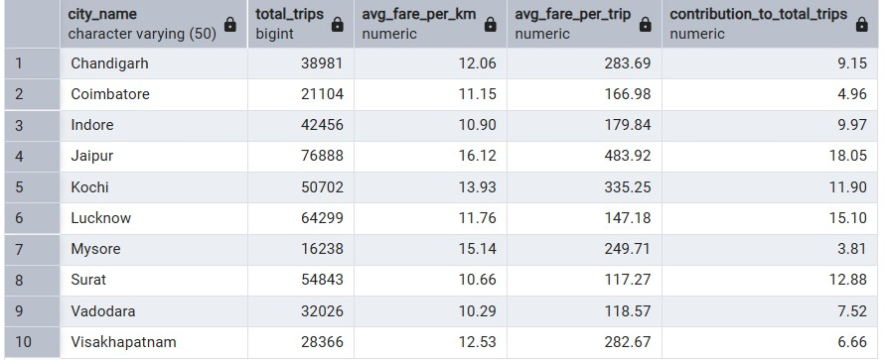
1. Generate a report that displays the total trips, average fare per km, average fare per trip, and the
percentage contribution of each city's trips to the overall trips.
Sarim Ahmad

Slide 18
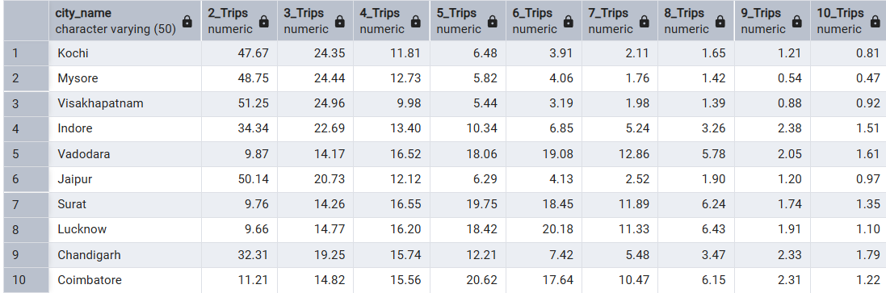
2. Generate a report that shows the percentage distribution of repeat passengers by the number of trips they have taken in each city. Calculate the percentage of repeat passengers who took 2 trips, 3 trips, and so on, up to 10 trips. Each column should represent a trip count category, displaying the percentage of repeat passengers who fall into that category out of the total repeat passengers for that city.
Sarim Ahmad

Slide 19
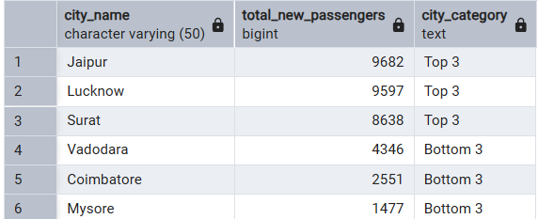
3. Generate a report that calculates the total new passengers for each city and ranks them based on this value. Identify the top 3 cities with the highest number of new passengers as well as the bottom 3 cities with the lowest number of new passengers, categorizing them as "Top 3" or "Bottom 3" accordingly.
Sarim Ahmad

Slide 20
Thank You
Sarim Ahmad

